Slide 1
Aspiration Towards Excellence
Name: ______________
Date: _______________
Class: _______________

Slide 2
What I Do Everyday
Everyday, I
1.) _______________________
2.) _______________________
3.) _______________________
4.) _______________________
5.) _______________________
and
6.) _______________________

Slide 3
Why Are They Important?
1.) ____________________ is important because _________ _______________________________________________.
2.) I ____________________________ because _________ _______________________________________________.
3.) I also think ____________________ is important because _______________________________________________.
4.) ____________________ is important because _________ _______________________________________________.
5.) Next is __________________. I know it is important for me because ______________________________________.
6.) And ______________________ is important because ____ _______________________________________________

Slide 4
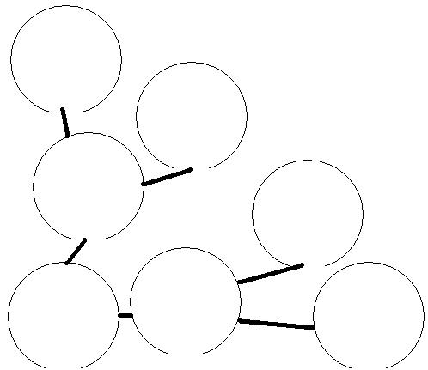
My Goal…
I would like to…
I need to ___________ , ________, ___________ and ________ for my future success. I want to help people and be helpful to whomever I meet.
They are important because They will help me achieve my dream and become a happy and productive individual in the society. I hope one day I become a good example to all who share my dream.

Slide 5
Why Should I Do My Best?
I want to be the best __________________ I can be.
Because of that, I must practice my English speaking skills, comprehension and understanding the topics I study and go to a good university.
Further more, I should ________________________________ ____________________________________________________________________________________________________________________________________________________________________________________________________ _____________________.Wish me luck.

Slide 6
What I Learned?
I interviewed _____________ last week and asked these questions:
1.) ______________________________________________ ______________________________________________________________________________________________
2.) ______________________________________________ ______________________________________________________________________________________________
3.) ______________________________________________ ______________________________________________________________________________________________

Slide 7
Conclusion
In conclusion, I must do my best because… __________________________________________________________________________________________________________________________________________________________________________________________________________________________________________________________________________________________________________________________________________________________________________________________________________________________________________________________________________________________________________Thank you for listening to my presentation. Have a ________ day.

