Slide 1
Aspiration Towards Excellence
Name: ______________
Date: _______________
Class: _______________

Slide 2
Introduction
In this presentation, I will first mention what I do everyday and give reasons for why they are important to me.
Next, I will _________________________________________ ____________________________________________________________________________________________________
Then I will talk about what I learned from others about their strive towards excellence. _____________________________________ _________________________________________________
Finally, I will conclude by _______________________________ ____________________________________________________________________________________________________
I hope you enjoy this presentation.

Slide 3

What I Do Everyday
Everyday, I
1.) _______________________
2.) _______________________
3.) _______________________
4.) _______________________
5.) _______________________
and
6.) _______________________

Slide 4
Why Are They Important?
1.) ____________________ is important because _________ _______________________________________________.
2.) I ____________________________ because _________ _______________________________________________.
3.) I also think ____________________ is important because _______________________________________________.
4.) ____________________ is important because _________ _______________________________________________.
5.) Next is __________________. I know it is important for me because ______________________________________.
6.) And ______________________ is important because ____ _______________________________________________

Slide 5
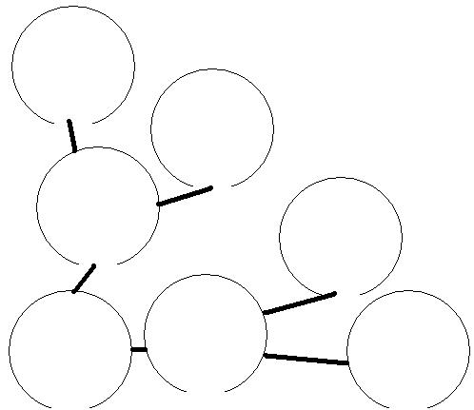
My Goal…
I would like to…
I need to ___________ , ________, ___________ and ________ for my future success. I want to help people and ______________________________ ______________________________
They are important because __________ ________________________________________________________________________________________________________________________

Slide 6
Why Should I Do My Best?
I want to ______________________________________
Because of _______________ I must _________________
________________________________________________________________________________________________________________________________________________________________________________________________________________________________________________________________________________________________________________________________________________________________________________________________________

Slide 7
What I Learned?
I interviewed _____________ last week and asked these questions:
1.) ______________________________________________ ______________________________________________________________________________________________
2.) ______________________________________________ ______________________________________________________________________________________________
3.) ______________________________________________ ______________________________________________________________________________________________

Slide 8
Conclusion
In conclusion, I must do my best because… __________________________________________________________________________________________________________________________________________________________________________________________________________________________________________________________________________________________________________________________________________________________________________________________________________________________________________________________________________________________________________Thank you for listening to my presentation. Have a ________ day.

